Slide 1
SC1015
Mini Project Vehicle Accidents
FCE2 - Team 7
Mohamed Faris, Mohamed Fazli, Muhammad Aidil Firdaus

Slide 2
01
Practical Motivation

Slide 3
Practical Motivation
1.9 Million killed
every year
Leading cause of death
for aged 5 - 29
Notes:
https://www.who.int/news-room/fact-sheets/detail/road-traffic-injuries

Slide 4
Problem Statement
What can be done to reduce the severity of road accidents?

Slide 5
Sample Collection
Kaggle
US-based accident statistics
2016-2023

Slide 6
02
Exploratory Analysis & Data Cleaning

Slide 7
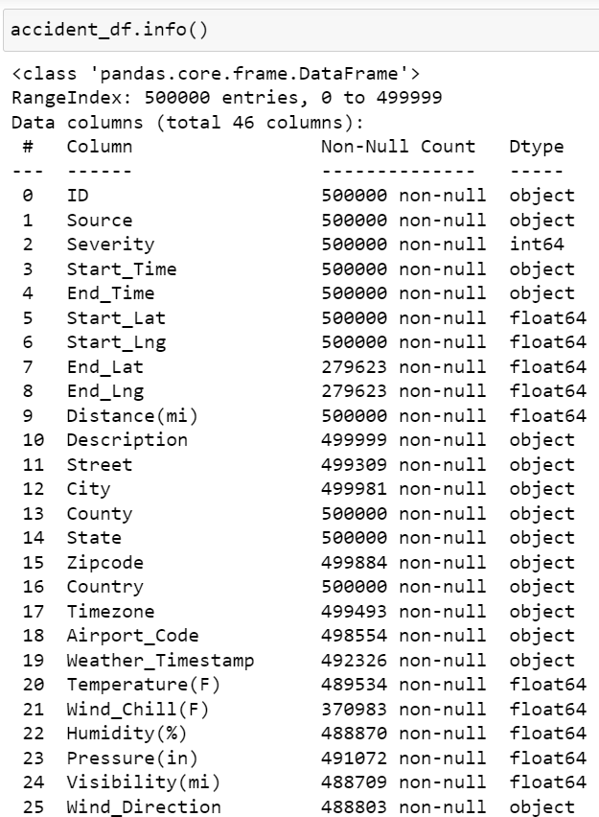
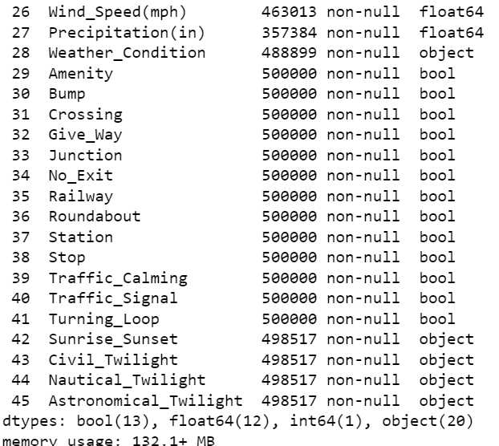
Preliminary Exploration
500,00 data points, 46 columns

Slide 8
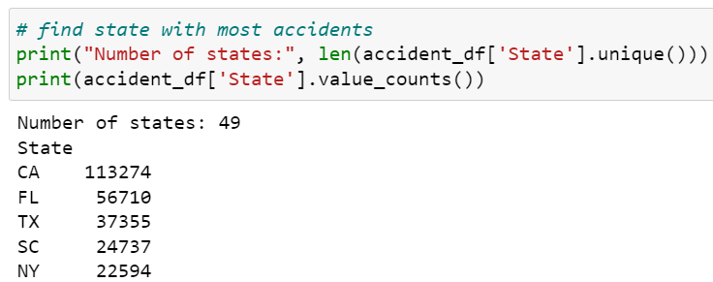
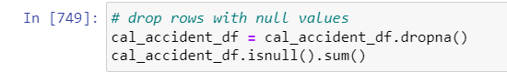
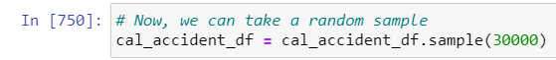
Data Cleaning
Choose California
Remove Null rows
Sample 30,000

Slide 9
Data Cleaning
Remove unnecessary columns:
ID, Source, End_Lng, End_Time, Description, State, Country, Timezone, Airport_Code, Weather_Timestamp, Roundabout, Turning Loop, Civil_Twilight, Nautical_Twilight, Astronomical_Twilight

Slide 10
Data Cleaning - Standardisation
Datetime
Start_Time
Conversion of Units
Distance(mi), Visibility(mi), Temperature(F), Wind_Chill(F), Precipitation(in), Pressure(in)
Zipcode
Zipcode
Sunrise_Sunset
Sunrise_Sunset
Wind_Direction
Wind_Direction

Slide 11
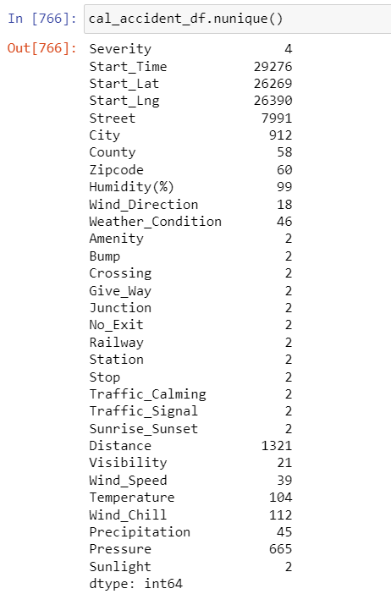
Data Cleaning - Simplification
Simplify categorical data since there are too many categories

Slide 12
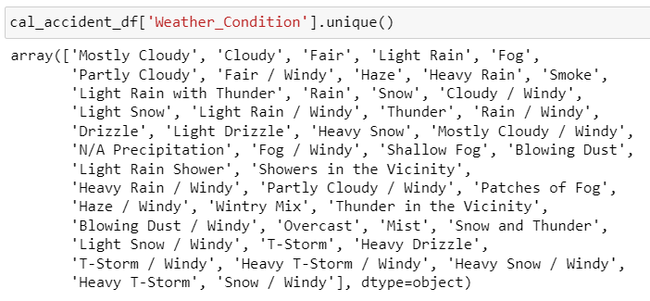
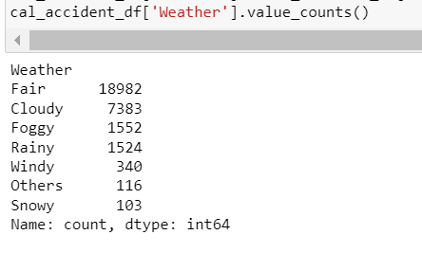
Data Cleaning - Simplification
Weather_Condition

Slide 13
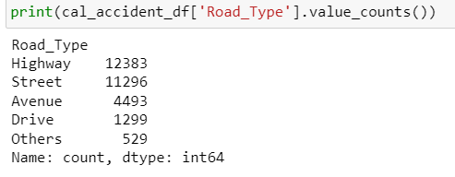
Data Cleaning - Simplification
Street

Slide 14
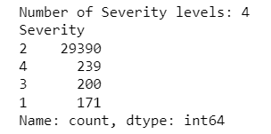
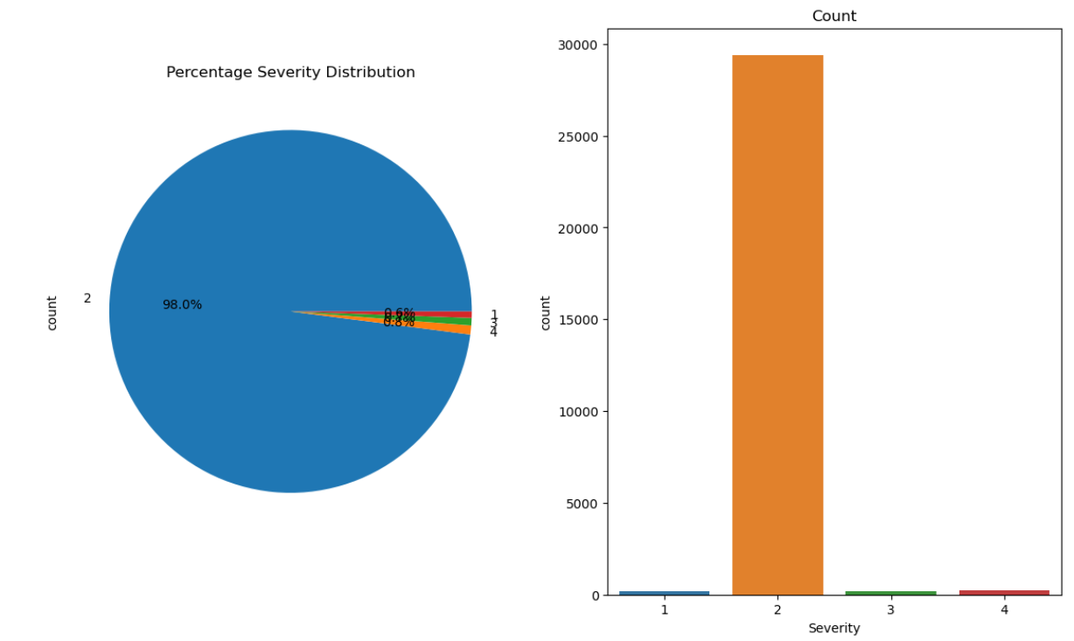
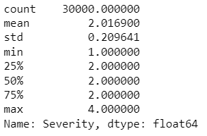
Exploratory Analysis - Severity

Slide 15
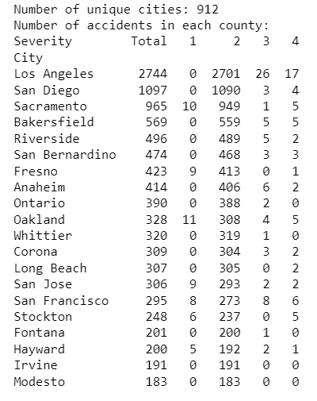
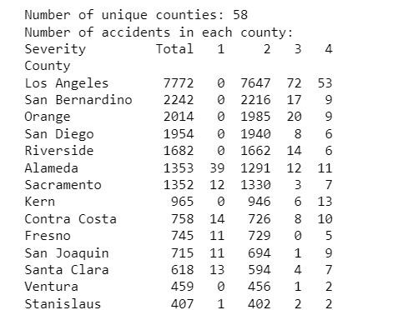
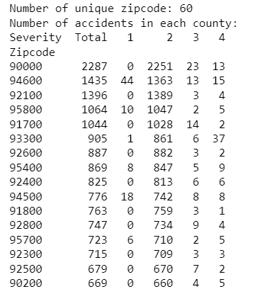
Exploratory Analysis - Location
City
County
Zip code

Slide 16
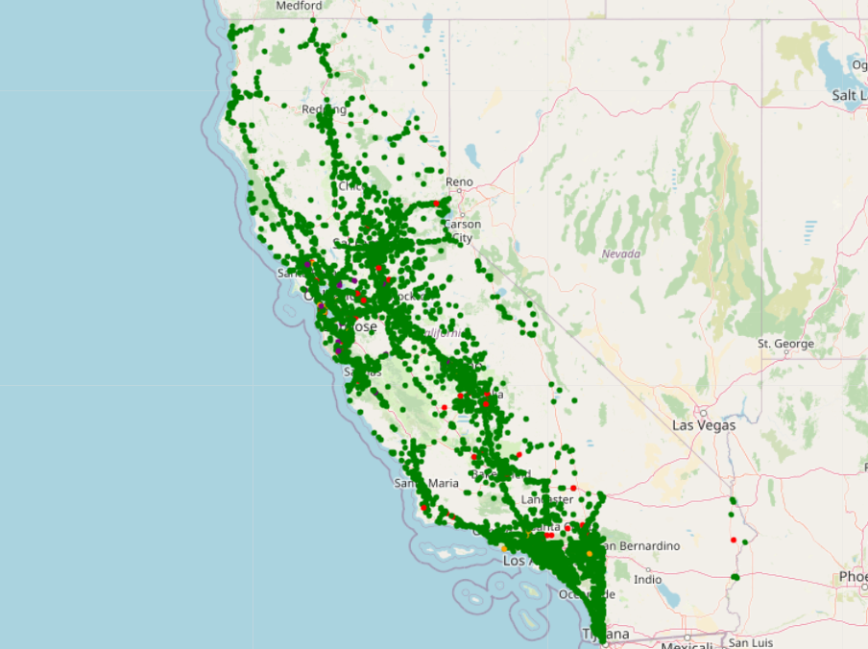
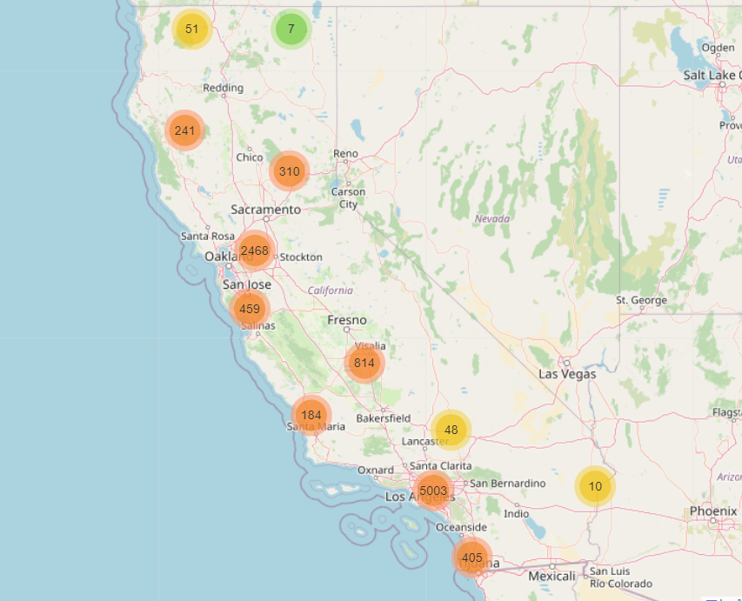
Exploratory Analysis - Location

Slide 17
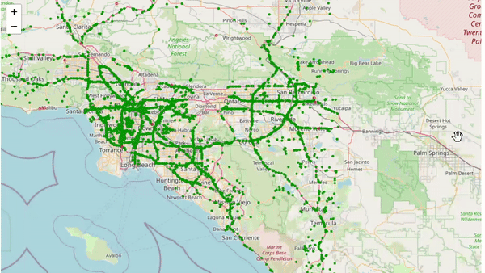
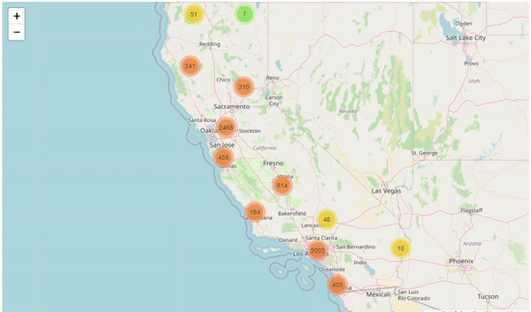
Exploratory Analysis - Location
Notes:
Accidents mostly occur at populated cities

Slide 18
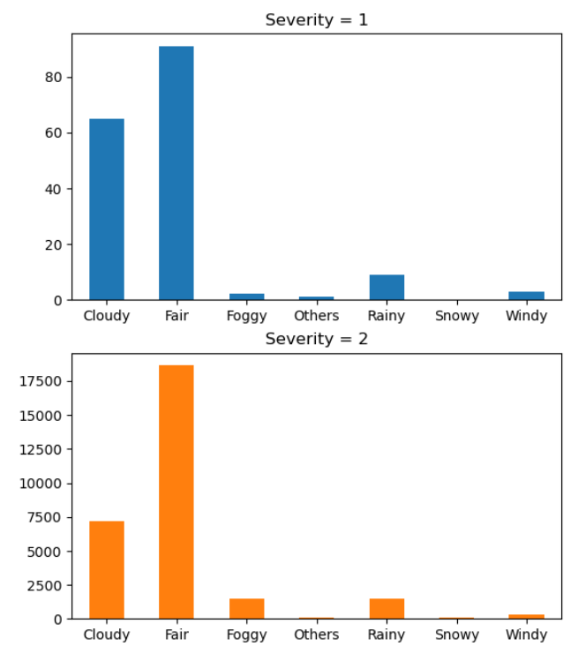
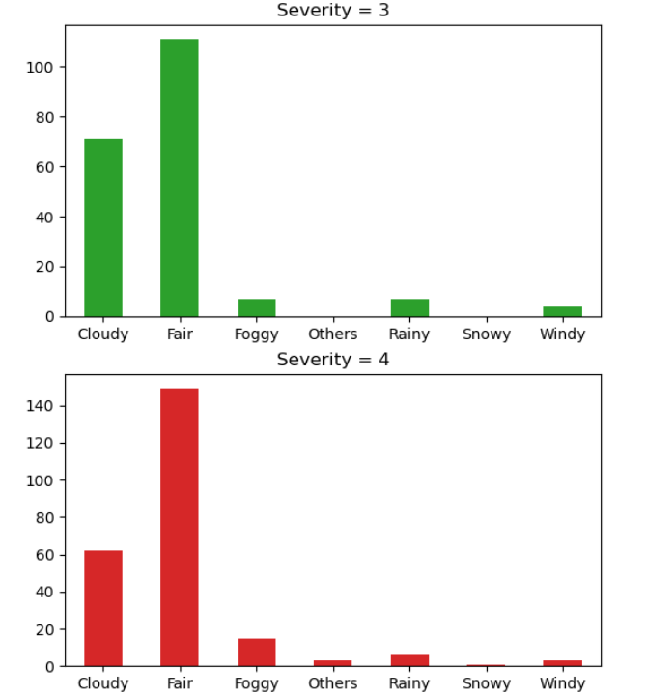
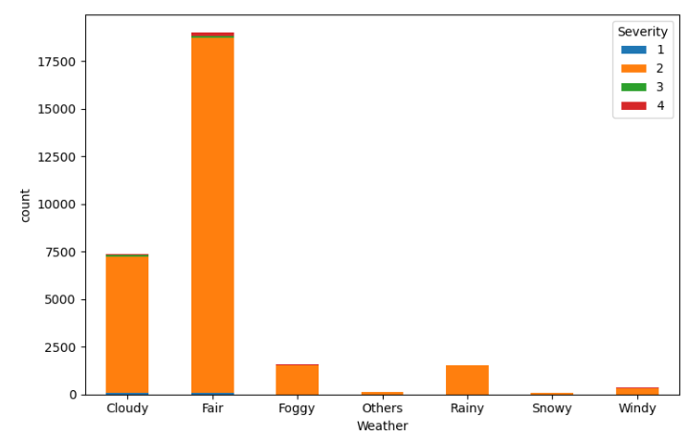
Exploratory Analysis - Weather Condition
Notes:
Good weather condition, high visibility

Slide 19
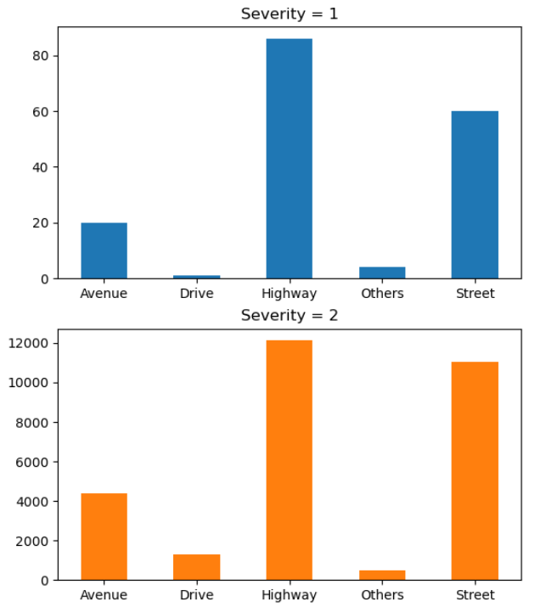
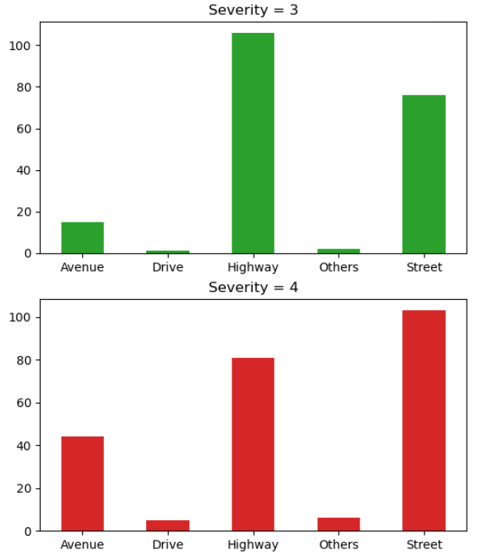
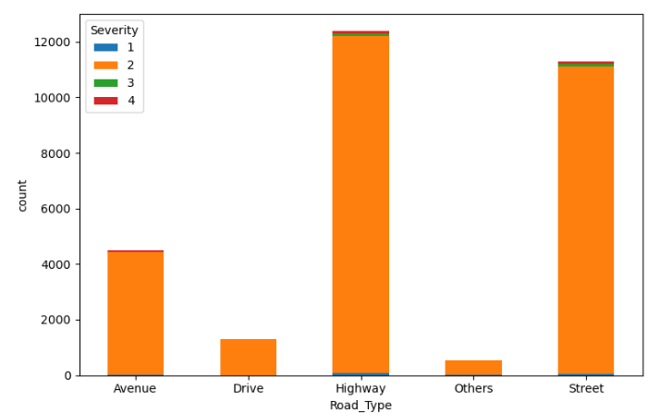
Exploratory Analysis - Road Type

Slide 20
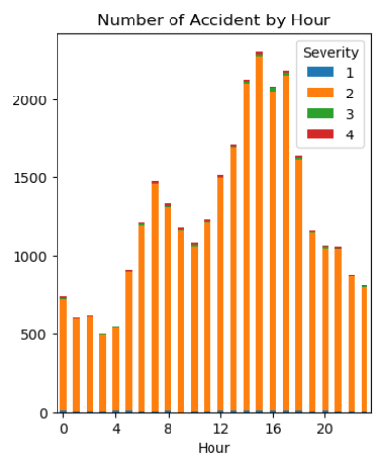
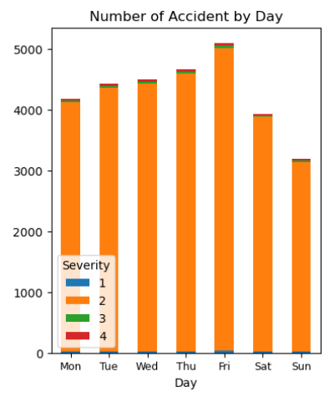
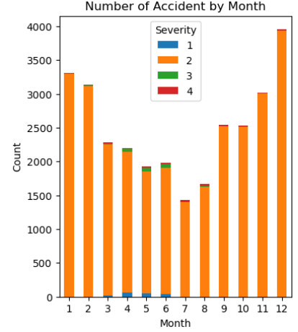
Exploratory Analysis - Date & Time
Notes:
On average, more accidents occur during starting and ending of the year, could be due to people going on holidays
Higher severity occur more during the middle of the year

Slide 21
Exploratory Analysis - Adding New Columns
From date & time analysis, the following columns are added
Is_Rush_Hour, Is_Christmas, Is_Weekday, Season
Notes:
On average, more occur during winter, road are slippery
However, higher severity accidents tend to occur during spring and summer, people driving faster

Slide 22
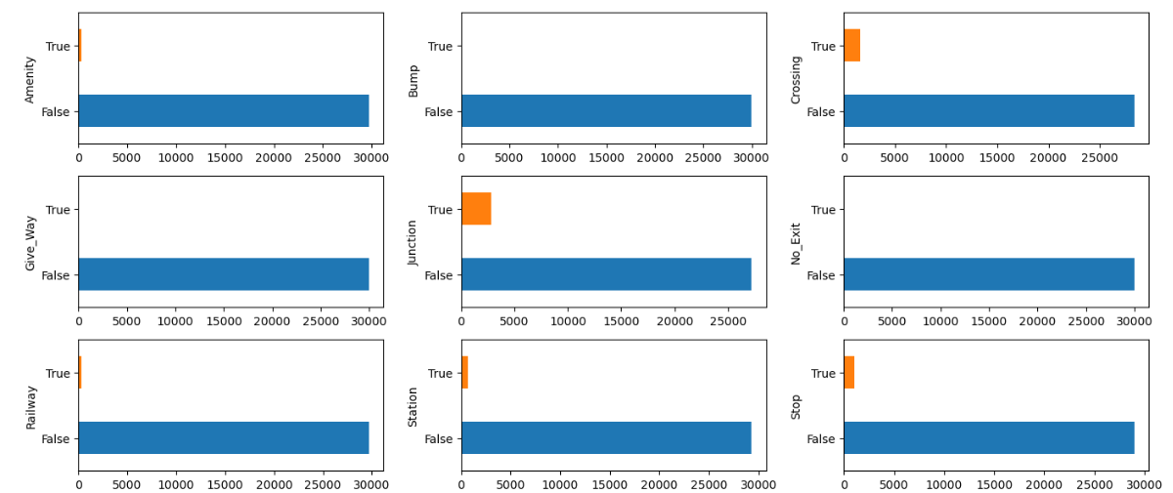
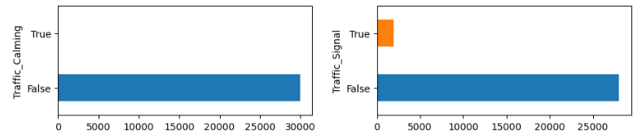
Exploratory Analysis - Boolean Values
Road Features
Notes:
Most accidents occur when there is no road features, indicating that road features help to reduce accidents since vehicles need to slow down

Slide 23
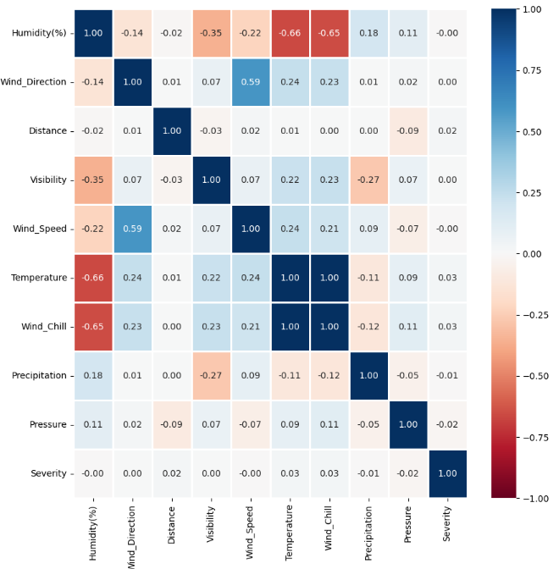
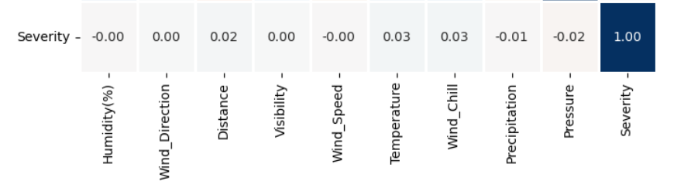
Exploratory Analysis - Numeric Values
Notes:
Numeric values shows no relation with severity of the accident

Slide 24
03
Data Preparation

Slide 25
Data Preparation
Need to ensure data is suitable for machine learning
Breaking down Start_Time into:
Year, Month, Day, Hour, Minute
Remove columns:
Start_Time, Street, Sunrise_Sunset, Weather_Condition
Convert column with object type to int using LabelEncoder module

Slide 26
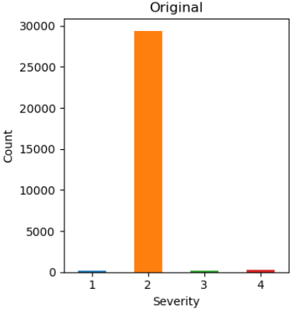
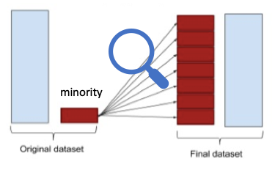
Resampling
Imbalance data
>95% of Severity is 2
Resampling will distribute data equally
Oversampling
Minority data expanded to majority data size

Slide 27
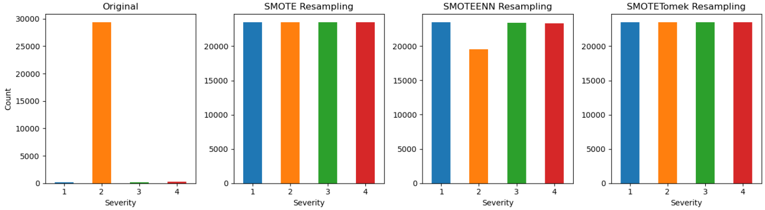
Resampling
3 different oversampling methods
SMOTE, SMOTEENN & SMOTETomek
SMOTE: creates new synthetic samples for the minority class by blending existing minority class
SMOTEENN: SMOTE + check classification with nearest neighbour
SMOTETomek: SMOTE + remove tomek links

Slide 28
04
Machine Learning

Slide 29
Machine Learning
Random Forest
Neural Network
Notes:
https://www.who.int/news-room/fact-sheets/detail/road-traffic-injuries

Slide 30
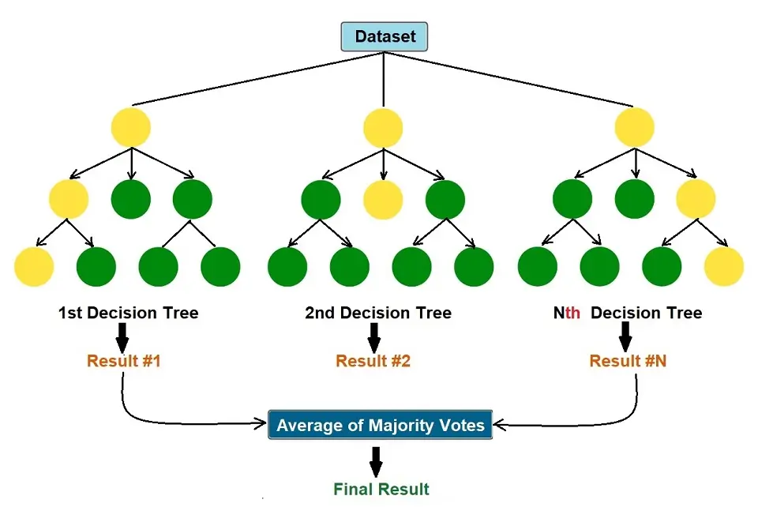
Random Forest
Uses multiple decision tree and combine the results
Good for dataset with many variables

Slide 31
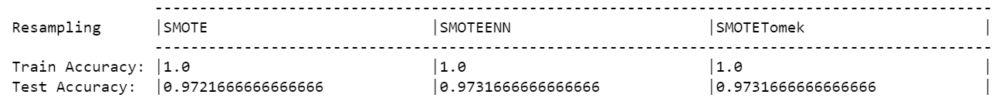
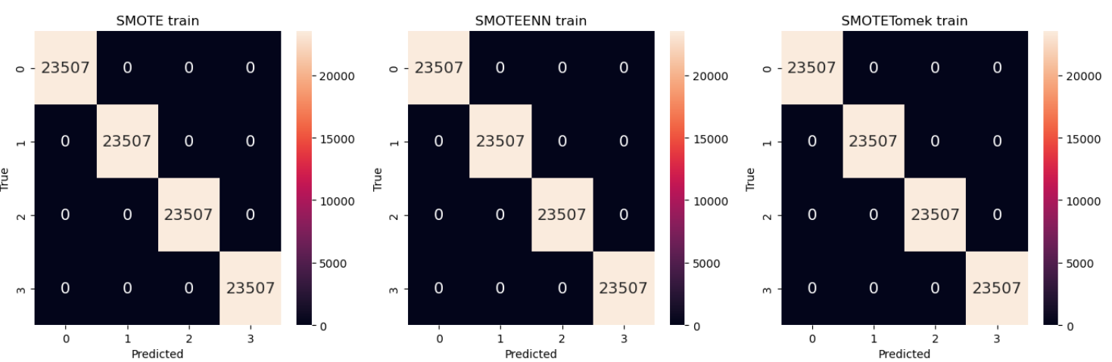
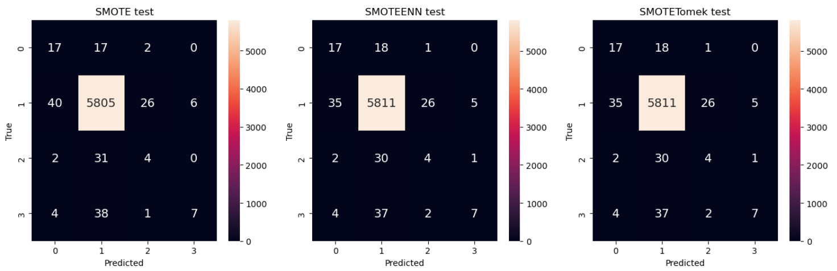

Slide 32
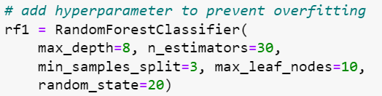
Overfitting
Random Forest model fits too closely with training data (perfect accuracy = 1.0)
Overcome this issue by changing hyperparameter of Random Forest Classifier

Slide 33
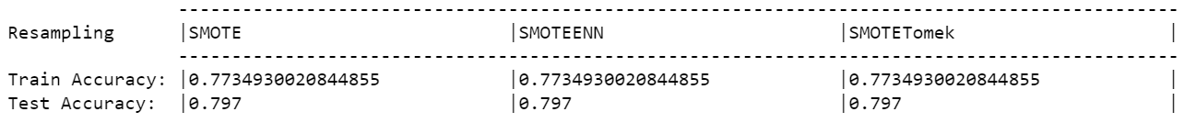
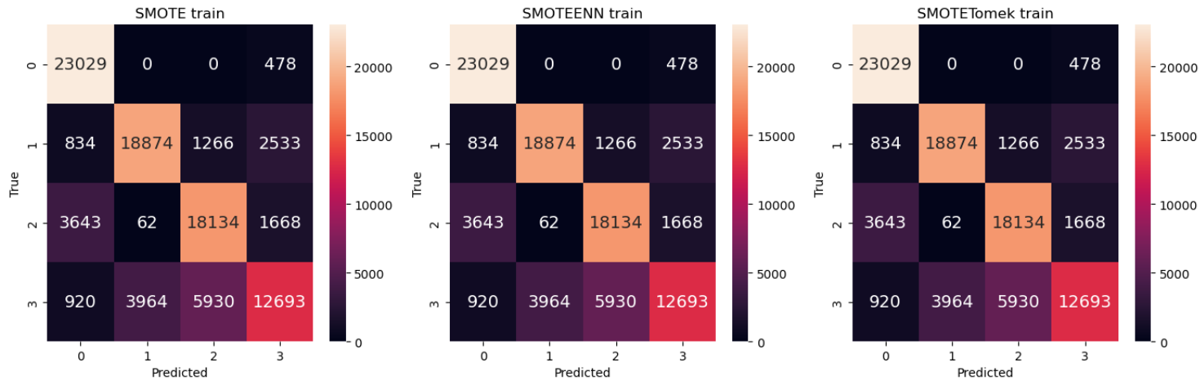
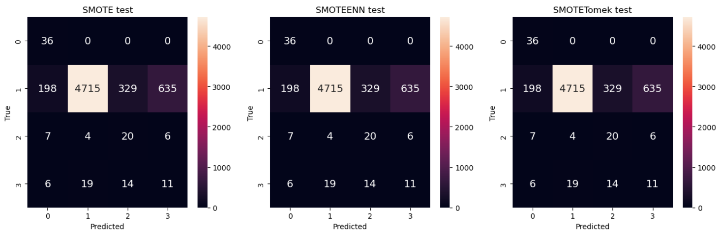

Slide 34
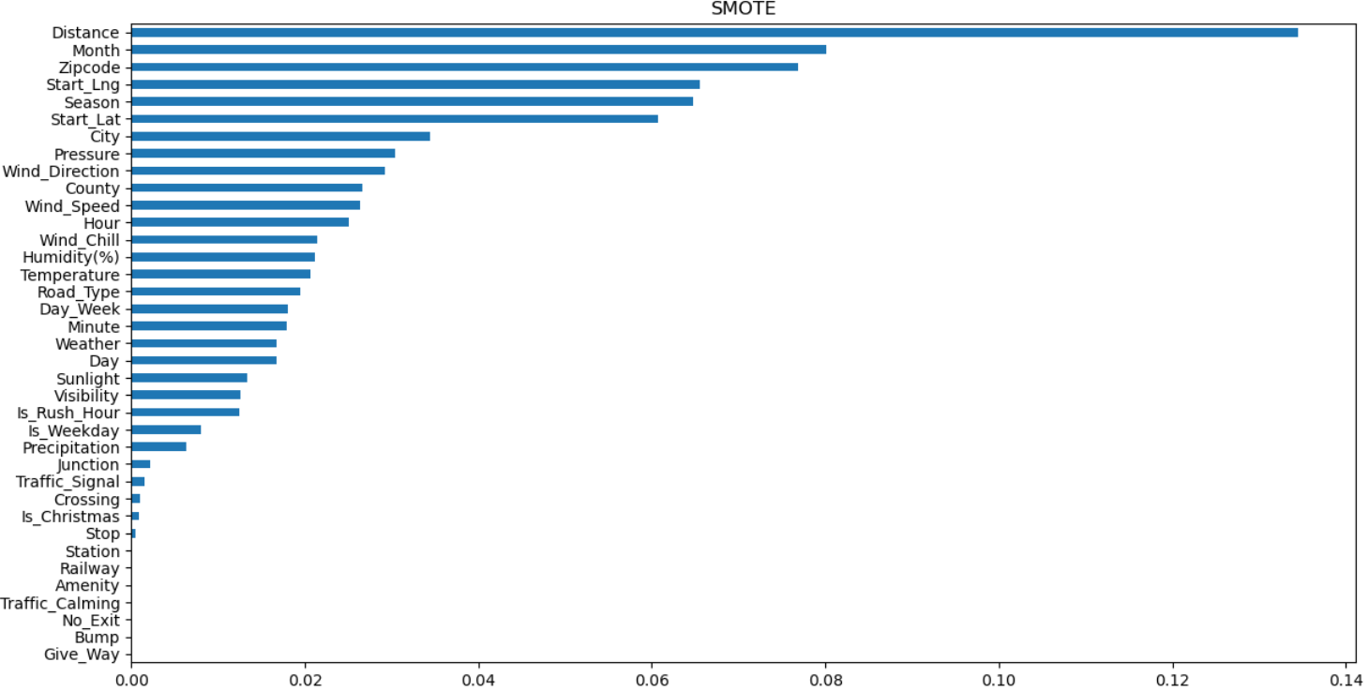
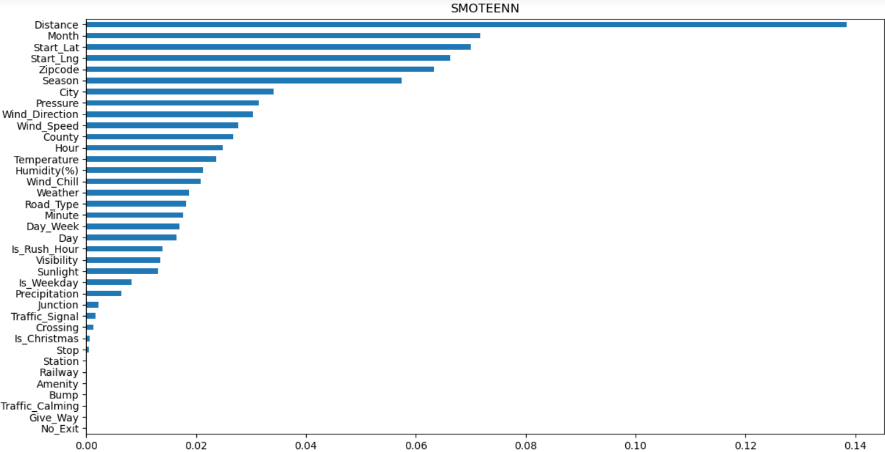
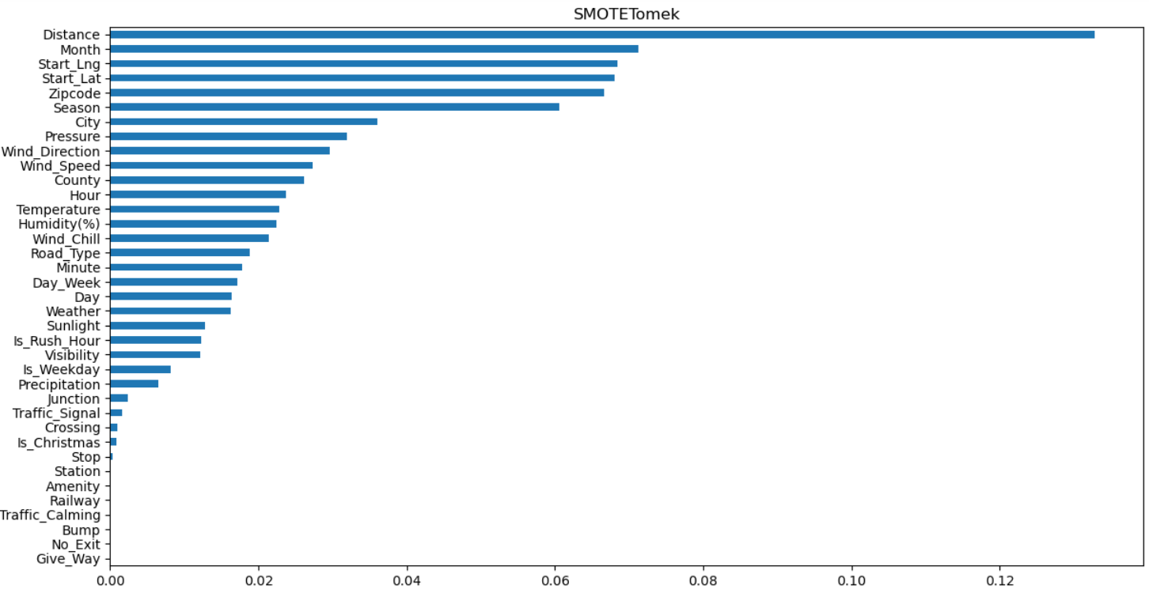
Feature Importance
Find the most important features from the Random Forest model in relation to Severity
Important Features:
Distance
Month
Start_Lng & Start_Lat (Location)
Similar across all 3 resampling techniques

Slide 35
Neural Network - Introduction
Input Layer
Hidden Layer 1
Hidden Layer 2
Hidden Layer 3
Output Layer
Features: Location, weather, wind etc
ReLu activation
ReLu activation
ReLu activation
Softmax activation (Severity Levels)
Notes:
In our project, I used machine learning classification techniques to solve the problem of predicting car accident severity levels. Specifically, I applied neural network models to classify the severity levels of accidents based on various features such as location, weather, and traffic conditions.
This diagram illustrates the architecture of our neural network model used to predict car accident severity levels. The model consists of an input layer, multiple hidden layers with ReLU activation functions, and an output layer with a softmax activation function.
The input layer receives features such as location, weather, and traffic conditions. These features are then processed through the hidden layers, each containing 16 units. The ReLU activation function is applied to introduce non-linearity and help the model learn complex patterns in the data.
The output layer uses a softmax activation function to predict the probability distribution of each severity level (1, 2, 3, or 4). This allows us to classify accidents into different severity levels based on the learned patterns from the hidden layers.

Slide 36
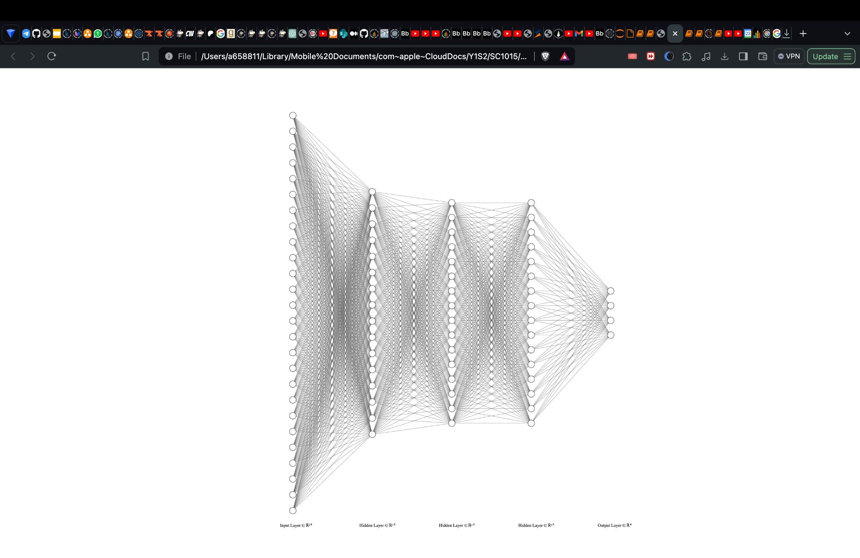
Neural Network - Introduction
ReLu activation
Features: Location, weather, wind etc
Softmax activation (Severity Levels)
Notes:
This is a more complete diagram of the different layers in our model.

Slide 37
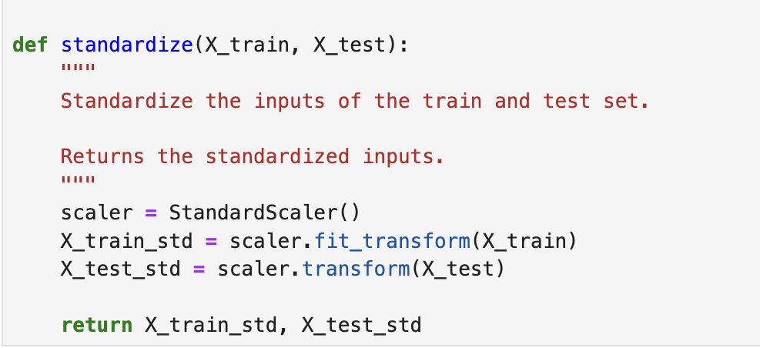
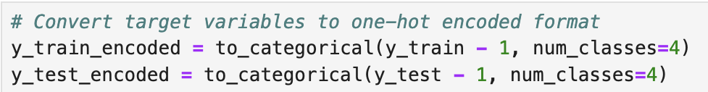
Neural Network - Helper functions
Standardizing numerical features
Encoding categorical features
Notes:
The main ML technique I used was neural networks, specifically multi-layer perceptron (MLP) models, implemented using TensorFlow/Keras. These models were chosen for their ability to handle complex, non-linear relationships in the data and their effectiveness in classification tasks.
I applied the MLP models to the dataset by first preprocessing the data, including standardizing numerical features and encoding categorical features.

Slide 38
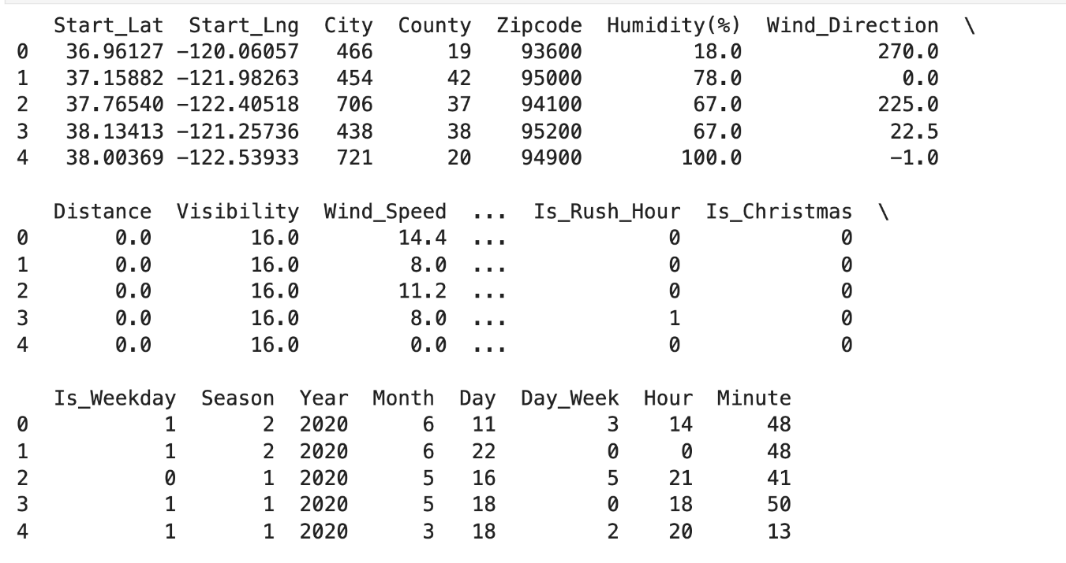
Neural Network - Features
Features: Location, visibility, wind speed, time of day etc
Notes:
In our project, I used machine learning classification techniques to solve the problem of predicting car accident severity levels. Specifically, I applied neural network models to classify the severity levels of accidents based on various features such as location, visibility, wind speed, time of day etc.

Slide 39

Neural Network - Create model
Dropout is included in each layer to prevent overfitting
Notes:
To prevent overfitting when creating the model, a dropout is included in each layer. Dropout randomly sets a fraction of input units to zero during training, which helps prevent the model from relying too much on certain features.

Slide 40

Neural Network - Create model
Softmax layer converts the model's output into a probability distribution over the severity levels
Categorical cross-entropy loss function is used to train the model by comparing these predicted probabilities with the actual severity levels in the training data.
Notes:
Furthermore, the final softmax layer converts the model's output into a probability distribution over the severity levels, and the categorical cross-entropy loss function is used to train the model by comparing these predicted probabilities with the actual severity levels in the training data. These components are essential for building and training a neural network model for multi-class classification, such as predicting car accident severity levels.

Slide 41

Neural Network - Resampling
Resampling techniques such as SMOTE, SMOTETomek, and SMOTEENN to handle class imbalance in the dataset.
Notes:
In addition to the tools and techniques learned in my course, I also learned about resampling techniques such as SMOTE, SMOTETomek, and SMOTEENN to handle class imbalance in the dataset. I applied these techniques to improve the performance of my models and mitigate the effects of class imbalance on the classification results.

Slide 42



SMOTE Model Training
SMOTETomek Model Training
SMOTEENN Model Training
Notes:
Here we can see the model training for all 3 models.

Slide 43

Results
Use SMOTETomek resampling method when we are trying to maximize F1 score.
Notes:
After running the model and comparing the training history and test performance between all 3 models, we conclude that we should use SMOTETomek resampling method when we are trying to maximise F1 score.

Slide 44
05
Conclusion

Slide 45
Conclusion - What we learned
Geospatial Analysis
Different resampling techniques
Different machine learning algorithms

Slide 46
Conclusion - Data Driven Insights
Drivers should pay more attention when roads are busy
Most accidents occur with busy traffic
Installation of more road features
Presence of road features -> Lesser accidents
Drivers should not be complacent with good weather conditions
More accidents when weather is good

Slide 47
Thank You

Slide 48
Reference
https://www.kaggle.com/datasets/sobhanmoosavi/us-accidents
https://www.who.int/news-room/fact-sheets/detail/road-traffic-injuries

